Slide 1
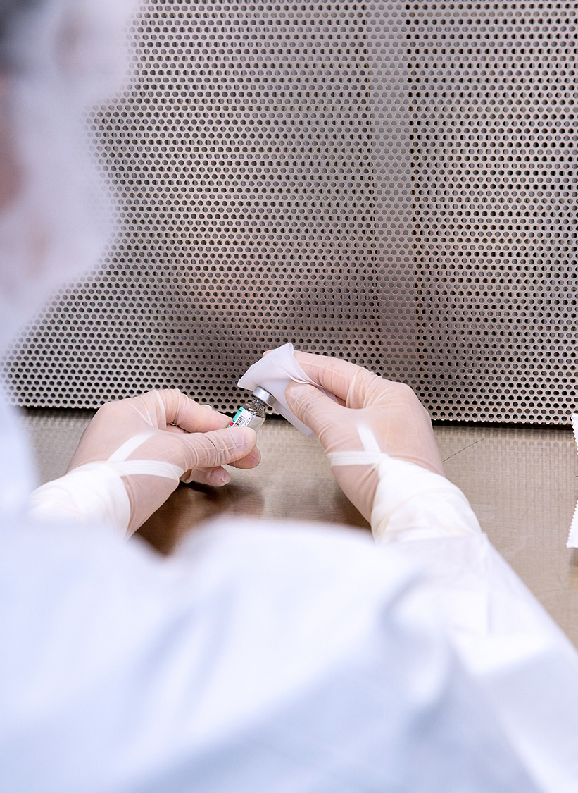
Holding The Pharmacy to the Same Standards as the Contract Micro Lab
Abby Roth, CMQ/OE
Pure Microbiology

Slide 2
Resources
You have a lot of reading to do!
USP <797> Pharmaceutical Compounding — Sterile Preparations
USP <1116> Microbiological Control and Monitoring of Aseptic Processing Environments
USP <1117> Microbiological Best Laboratory Practices
CETA CAG-009 Viable Environmental Monitoring for Sterile Compounding Facilities
ISO 14698-1:2003 Cleanrooms and Associated Controlled Environments
FDA’s Aseptic Processing Guidance
CDC’s Biosafety in Microbiological and Biomedical Laboratories
State and local requirements for biohazardous waste

Slide 3

Use USP <1117> as Your Guide
Training of laboratory staff
Appropriate lab layout
Use and control of equipment
Incubation and temperature excursions
Media receipt, storage, and QC testing
Sample handling and analysis
Recordkeeping and evaluation of data

Slide 4
Training of Laboratory Staff
Yes, you have lab staff!
“Designated person(s) must ensure that SOPs are appropriate and are implemented, which includes ensuring that personnel demonstrate competency in performing every procedure that relates to their job function.”
-USP <797> (2022)

Slide 5
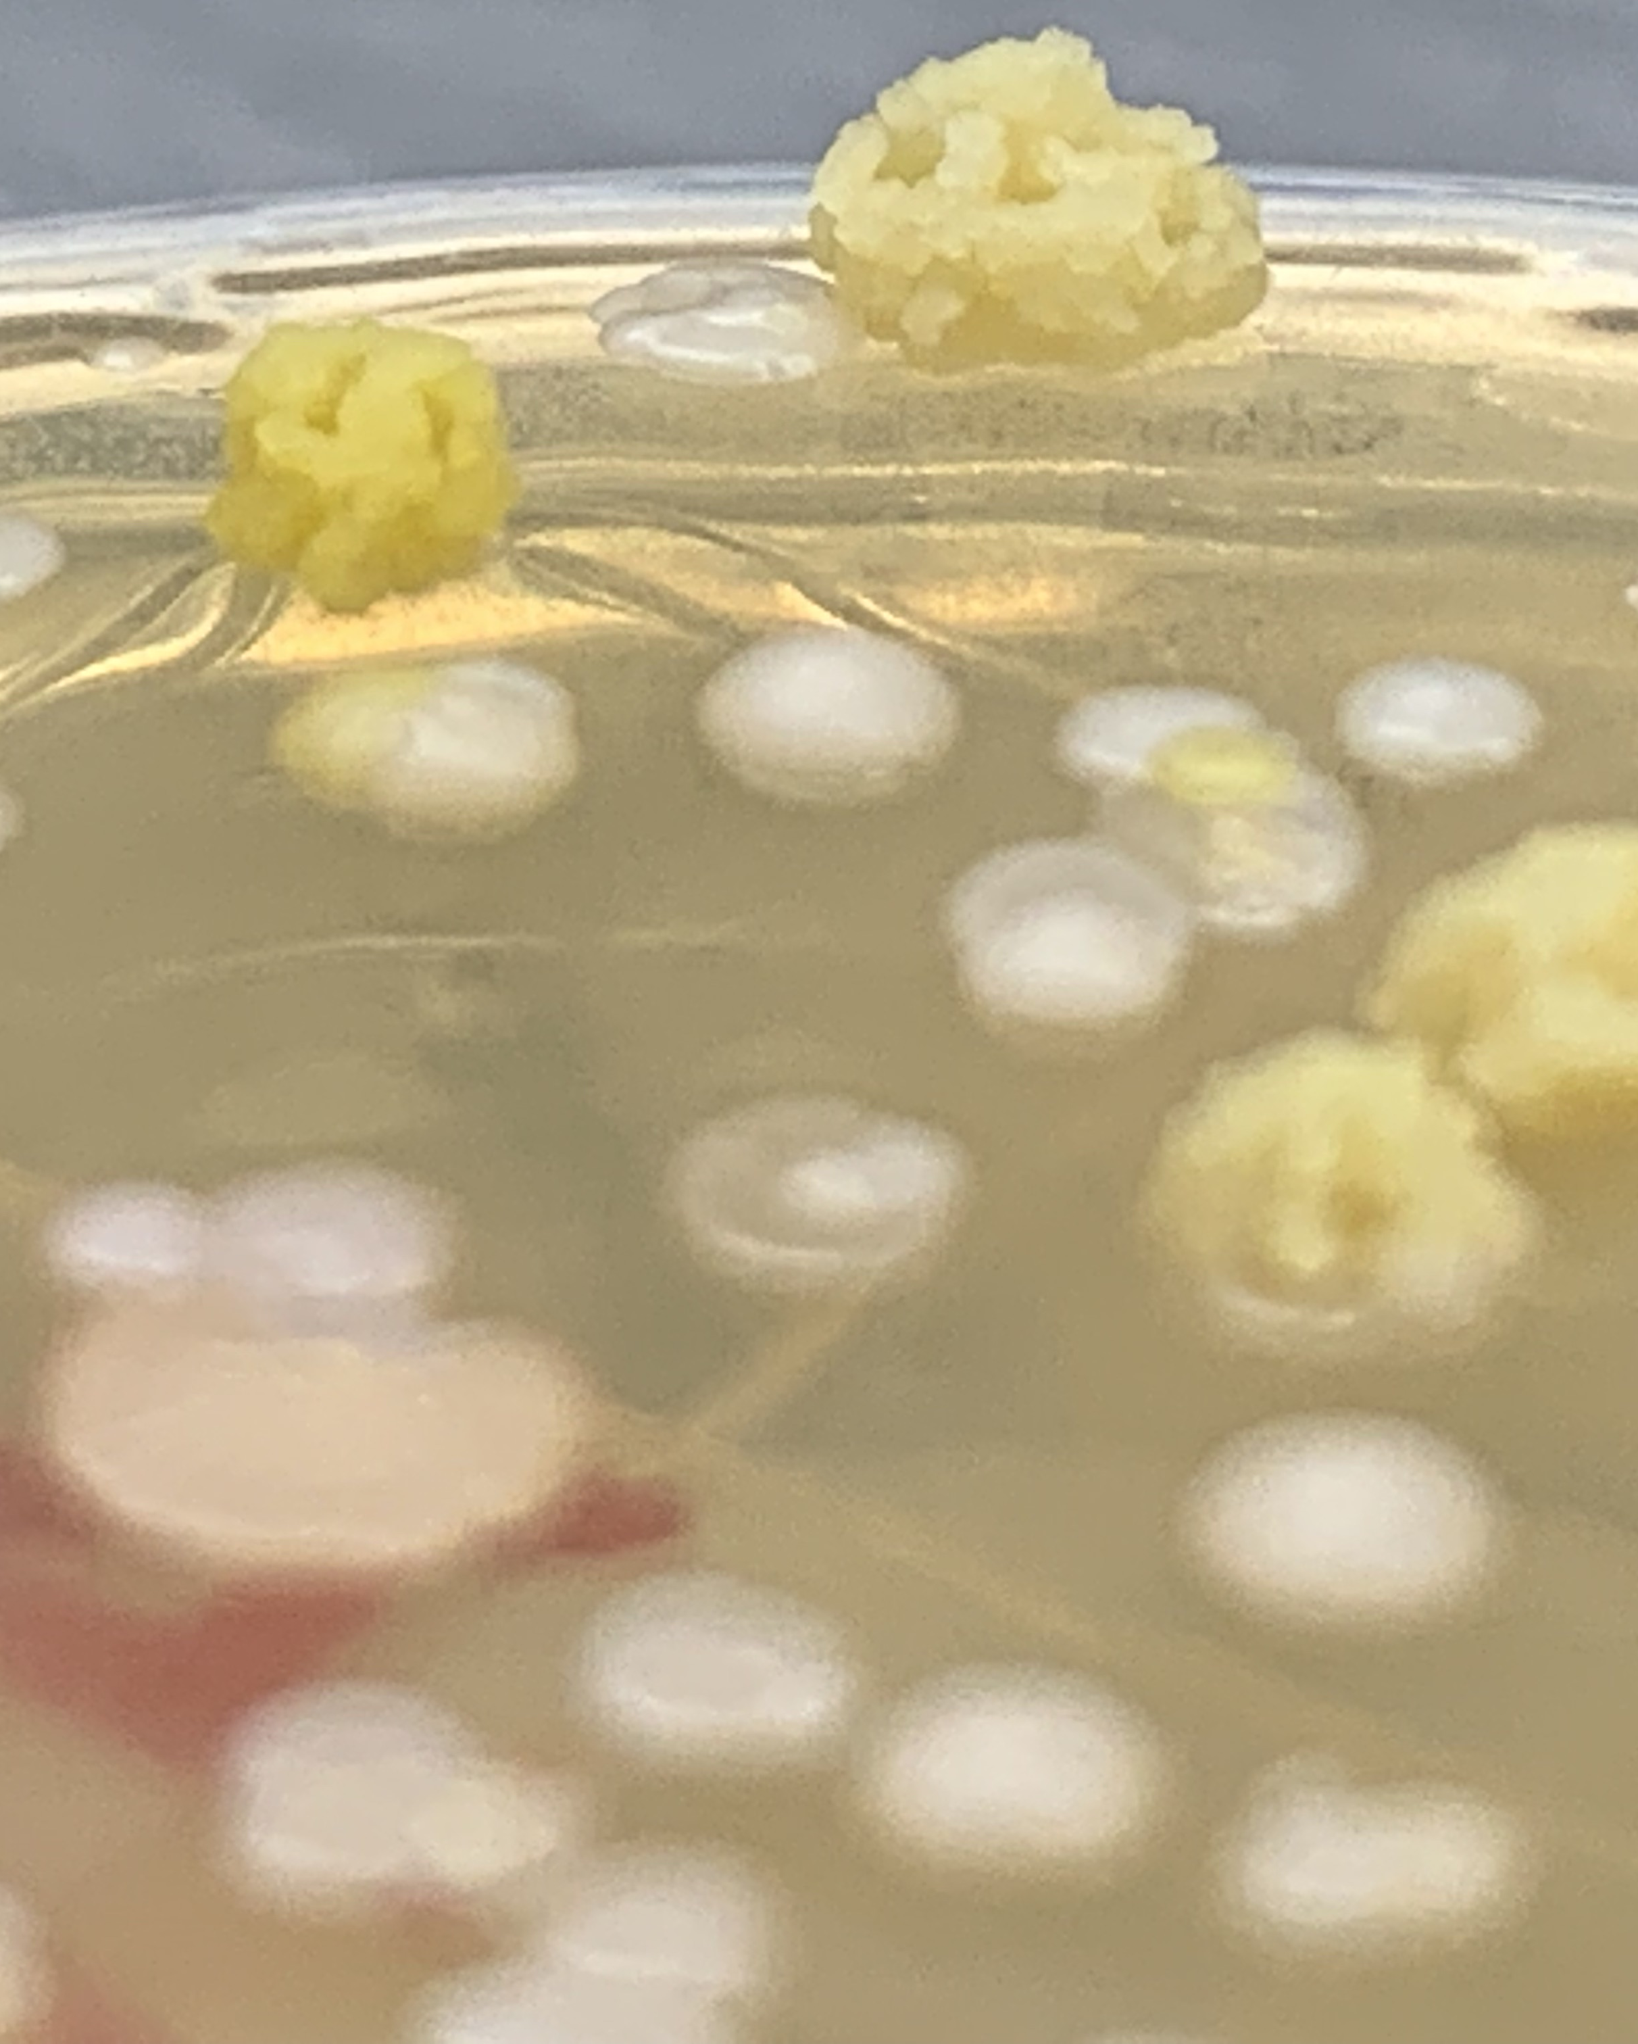
Training Checklist
These are the minimum!
    Incubation
    Counting colonies
    Reading media-fill tests
    Documentation
    Shipping samples to the contract lab
    Sample disposal
    Identifying exceeded action levels

Slide 6
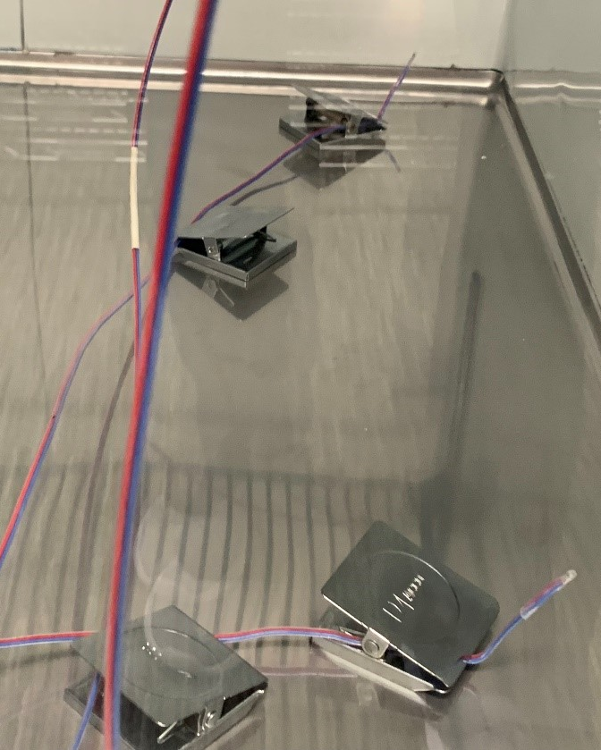
Equipment Validation
Part of equipment qualification
    Installation Qualification (IQ)
  Operational Qualification (OQ)
  Performance Qualification (PQ)
Includes
  temperature mapping
  open door study
  power-off study

Slide 7
Media-Fill Incubation
Your choice but option 1 matches FDA’s guidance.
Option 1
Stage 1: 20 to 25 °C for at least 7 days
Read at end of 1st incubation
Stage 2: 30 to 35 °C for at least 7 days
Read at end of 2nd incubation
Option 2
Stage 1: 30 to 35 °C for at least 7 days
Read at end of 1st incubation
Stage 2: 20 to 25 °C for at least 7 days
Read at end of 2nd incubation
Notes:
Chapter does not specify to read after the first incubation

Slide 8
Plated Media Incubation – Single Plate Method
Best Practice
Stage 1: 30 to 35 °C for 48 hours to 4 days
Read at end of 1st incubation
Stage 2: 20 to 25 °C for 5 to 7 days
Read at end of 2nd incubation
TSA ONLY
Notes:
Chapter does not specify to read after the first incubation

Slide 9
Plated Media Incubation – Dual Plate Method
Best Practice
30 to 35 °C for 48 hours to 4 days
Read at end of 1st incubation
20 to 25 °C for 5 to 7 days
Read at end of 2nd incubation
TSA
Fungal
20 to 25 °C for 5 to 7 days
Read at end of incubation
Notes:
Chapter does not specify to read after the first incubation

Slide 10
Media Manufacturer Qualifications
Manufactures, processes, and packages according to 21 CFR 820
Has an ISO Certificate of Registration as an ISO 9001 or ISO 13485 facility
Registered with the Food and Drug Administration

Slide 11
Recordkeeping
According to USP <1117>
Microbiologist training and verification of proficiency
Equipment validation, calibration, and maintenance
Equipment monitoring during test
Critical aspects of test conducted as specified by a procedure
Data and calculations verification
Reports reviewed by quality department or a qualified responsible manager
Investigation of data deviations

